Slide 1
Class lecture Monday after Labor Day
ATM 651 Fall 2022
Brian Mapes
Zoom recording FWIW: https://miami.zoom.us/rec/share/yfPtyHXWDstOMx2eCYfZ1rzclMImQaCPJ4vH_ju8OQl_yPo_mqYajJJi5vtNkB29.QuyNBM0XJQzd4jXq Passcode: 74e5Z=qi

Slide 2
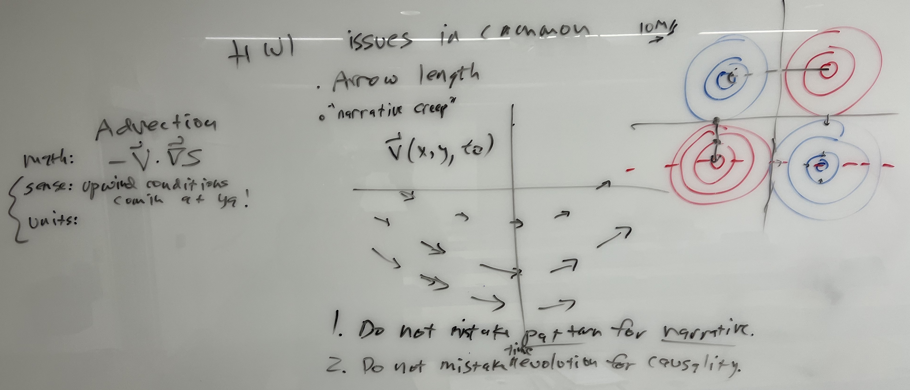
HW1 : some common errors

Slide 3
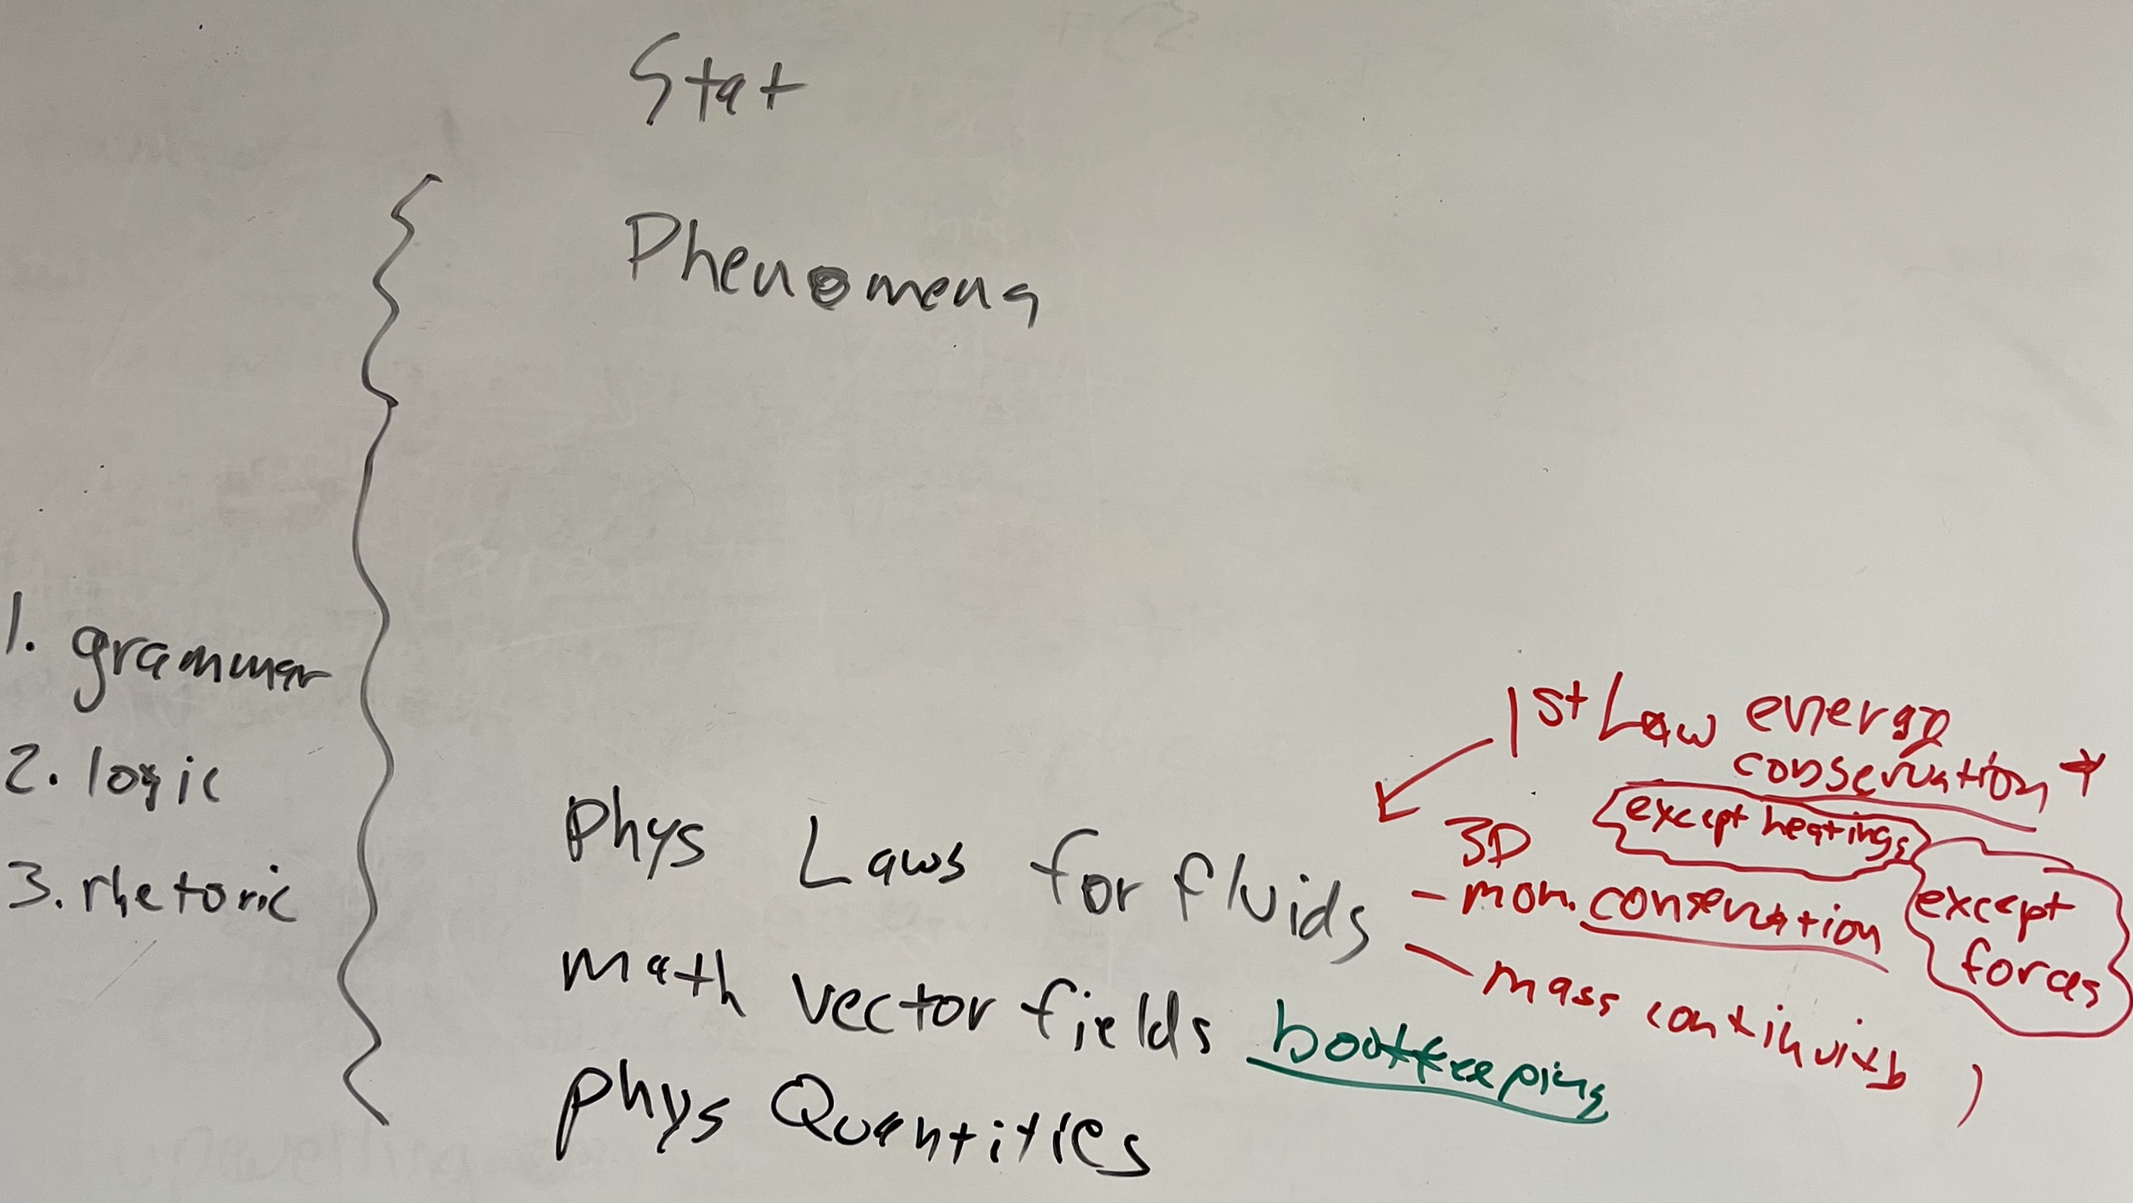
Where we are working today in course stack

Slide 4
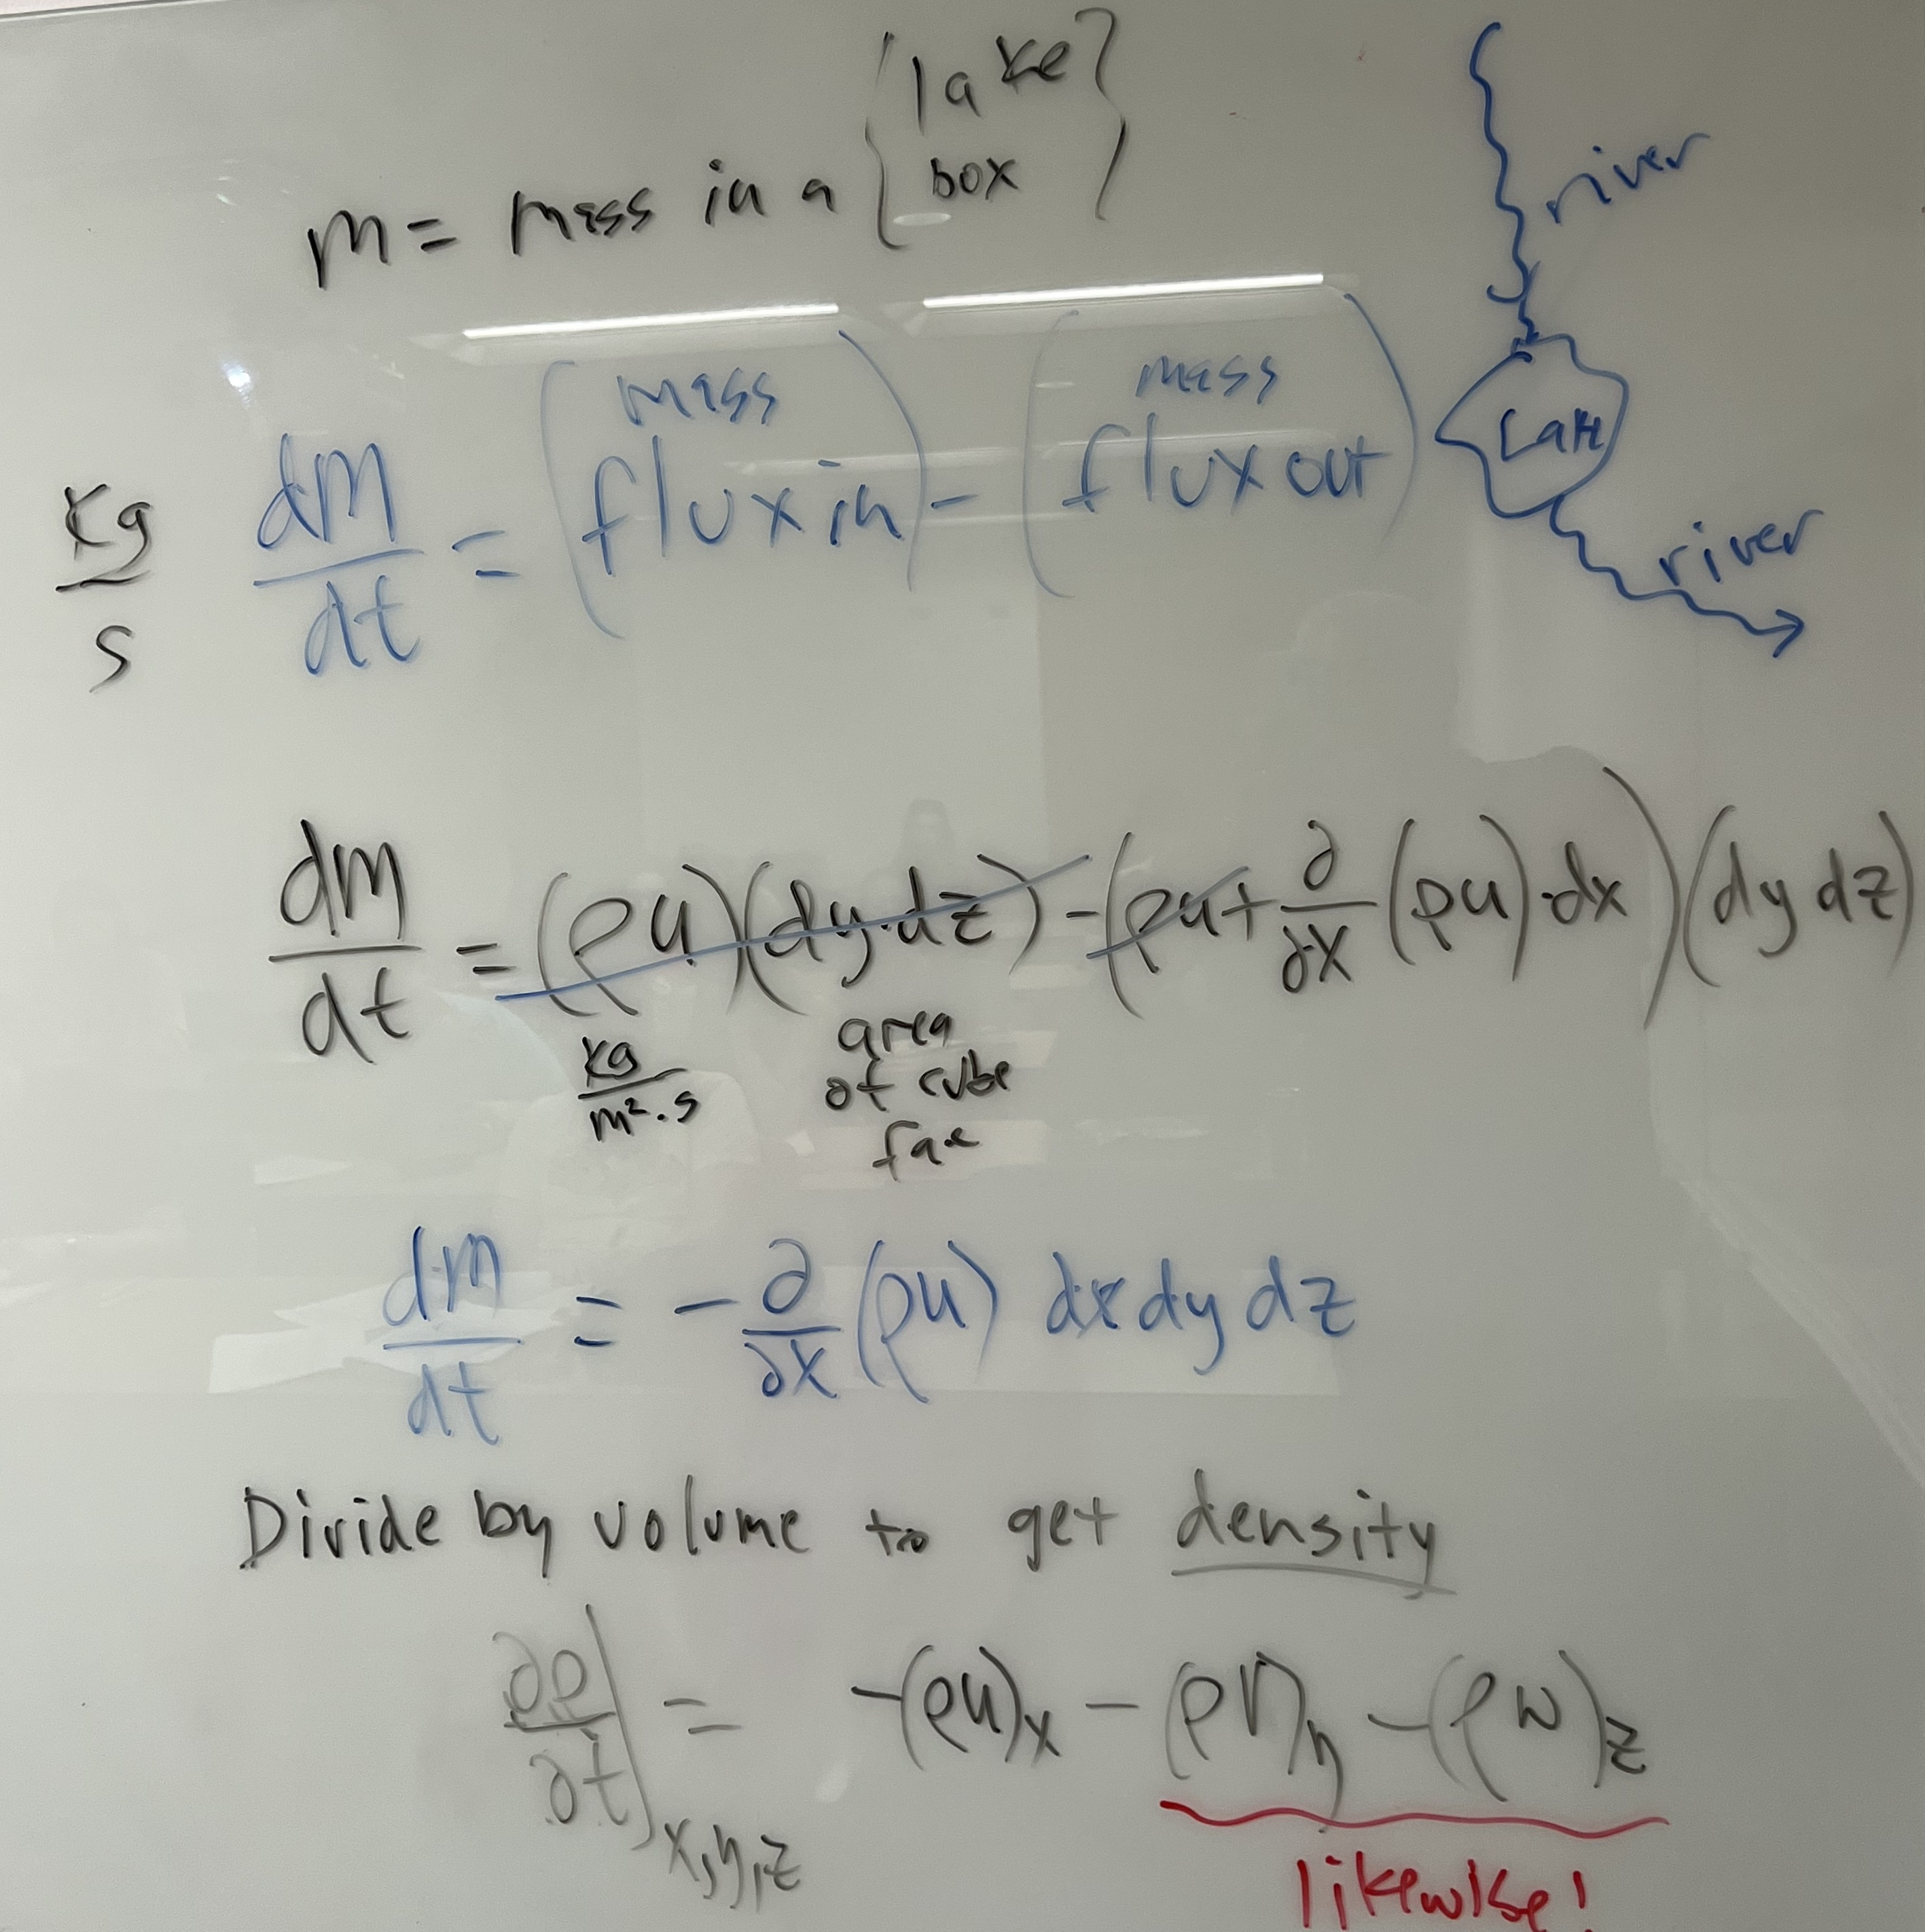
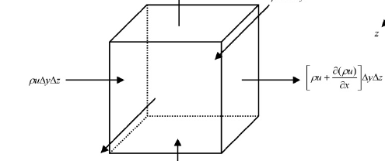
That Cube Thingy for mass continuity

Slide 5
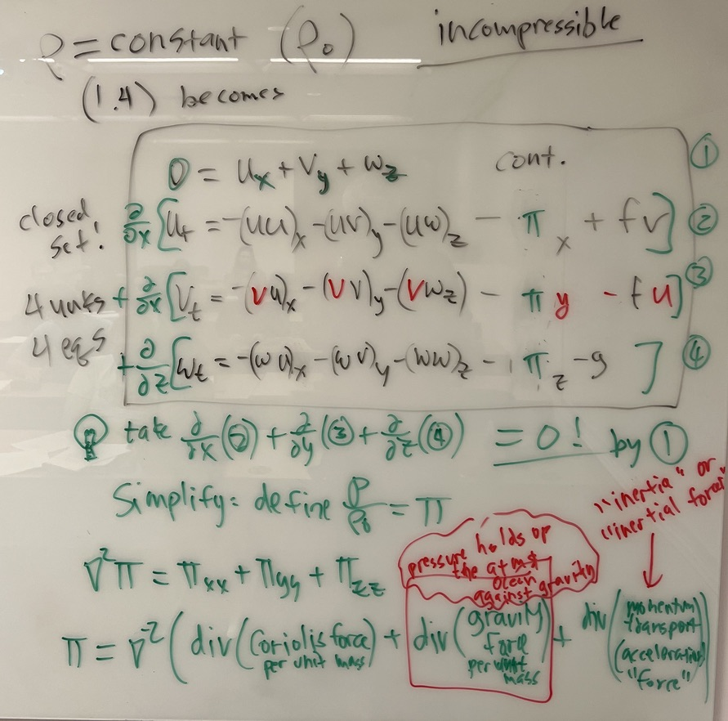
Our First Closed Set!
mass continuity (absolute conservation everywhere)
momentum conservation except for forces
It becomes an equation for pressure →

Slide 6
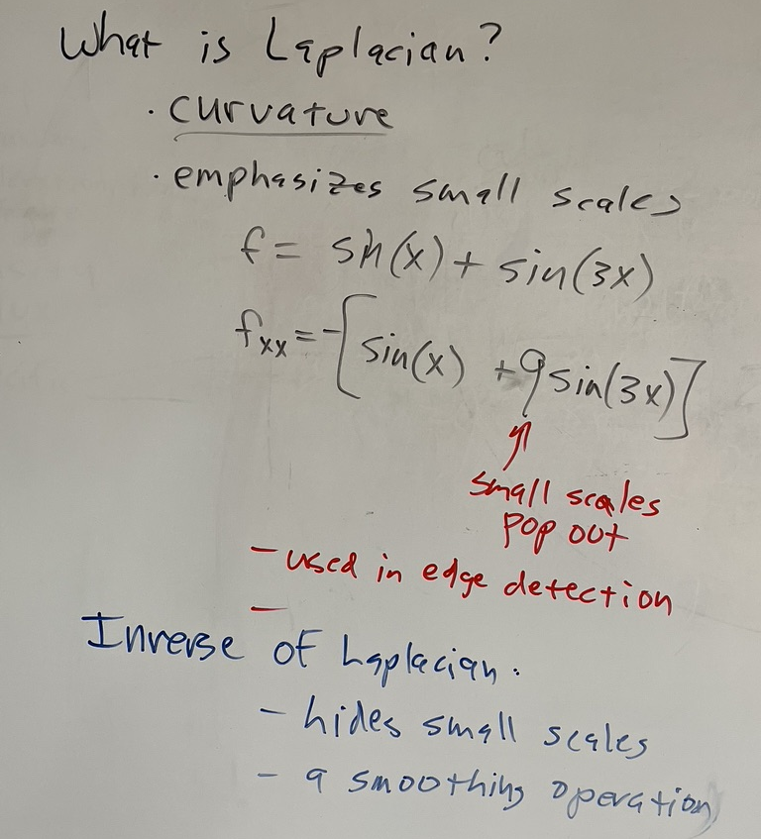

What is this inverse Laplacian operation?
It smooths the complicated fields that are its inputs
(divergence of forces).

Slide 7
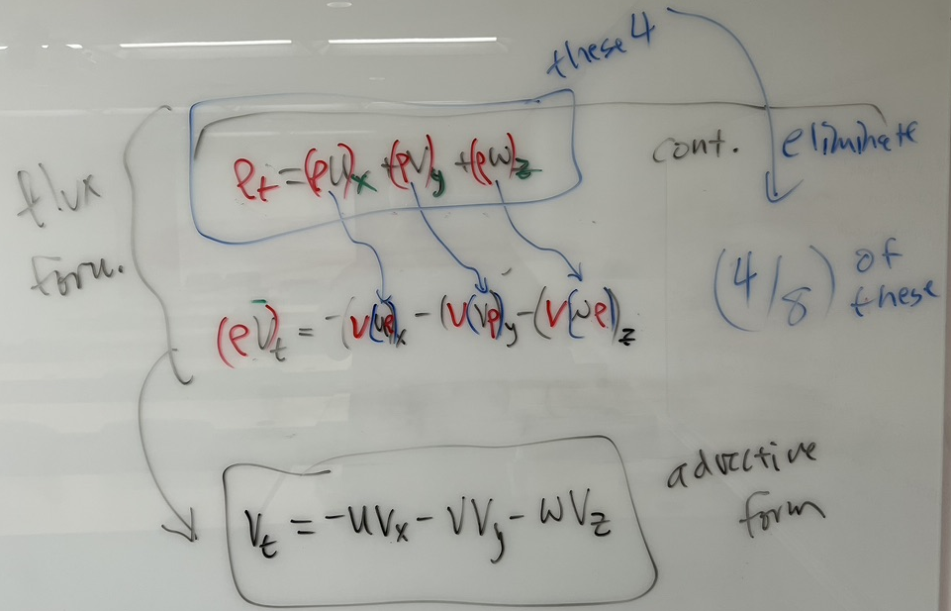
Tips for: deriving advective from from flux form Treat (rho*V) as one thing, don’t sub-differentiate it.

